Slide 1










Wisteria
- Company Specific Recruitment System -
Projet Manager & Database Architect:
Claudio Chiocchetti
Lead Java Developer & API Architect:
William Solari
Design Lead & UI/UX Designer:
Diego Usai
Frontend Developer & HTML Specialist:
Giacomo Terrile
Backend Developer & Security Lead:
Edoardo Rossi

Slide 2

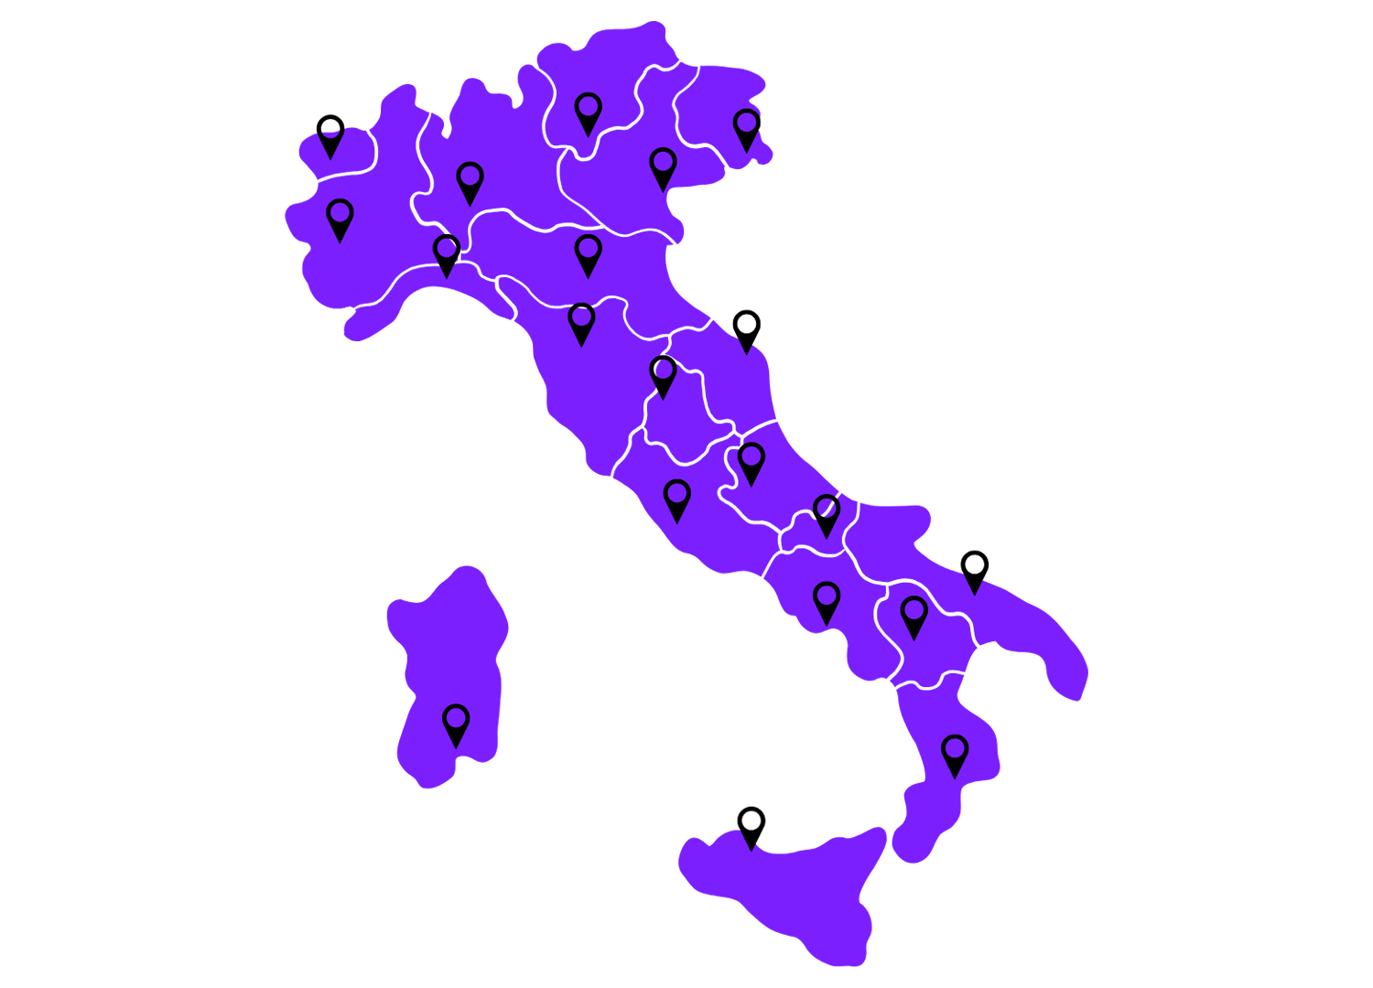






OUR COMPANY
Italian Software House
Custom Software Development
Mobile App Development
Web Development
Cloud Solutions
AI and Machine Learning
Cybersecurity Solutions

Slide 3




PROBLEMS
Multiple recruitment platforms fees
Poor compatibility with HR division
Privacy Concerns
Poor Customization

Slide 4






DEVELOPMENT TOOLS
FRONT-END
BACK-END
HTML
CSS
JAVA
JSP
JAVASCRIPT
TOMCAT
SQL SERVER

Slide 5
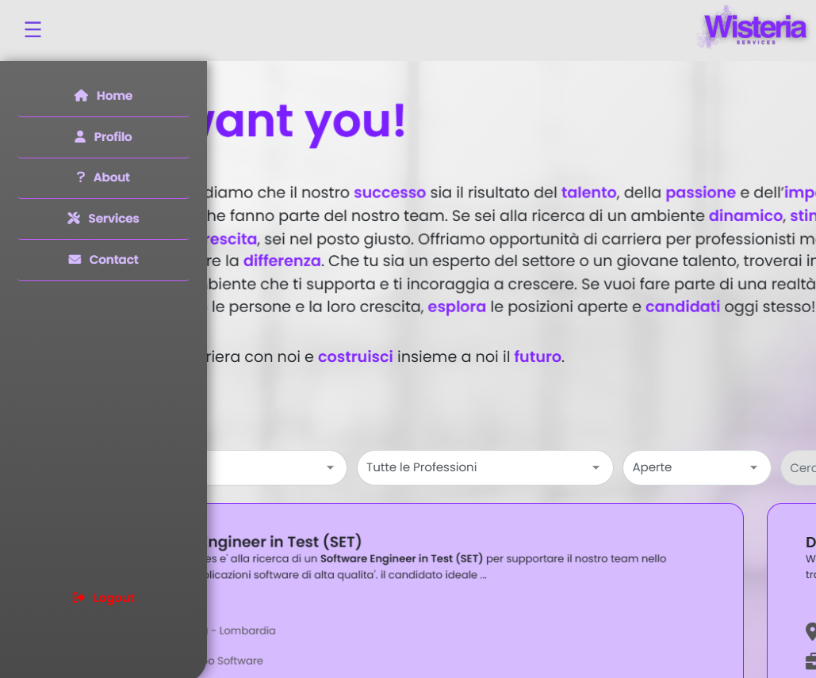
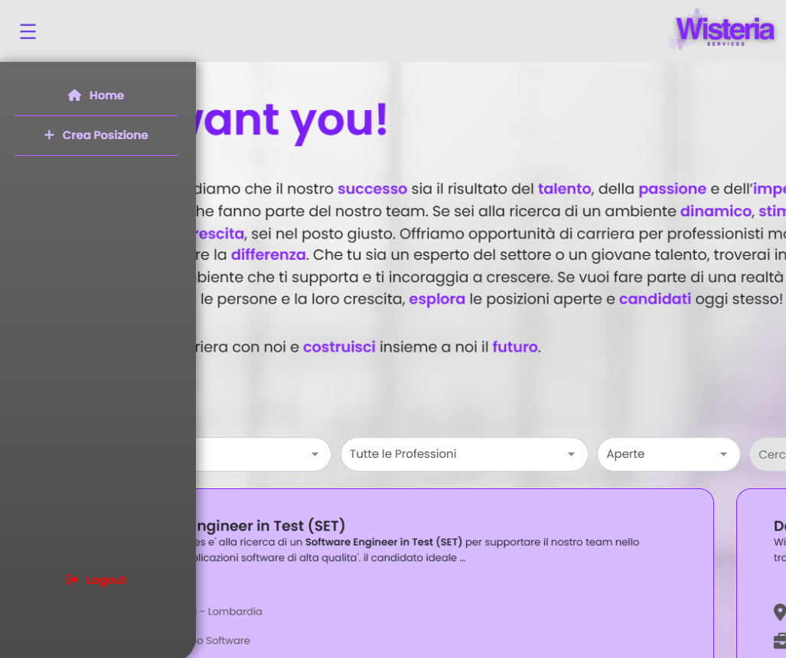
USER INTERFACE
CANDIDATE
ADMIN

Slide 6


SCALABILITY
- Write once, reuse everywhere -
USER
INHERITANCE
POLYMORPHISM
∞
CANDIDATE
ADMIN
"The most important property of a program is whether it can be easily modified to suit new needs.“ - Niklaus Wirth (Creator of Pascal)

Slide 7

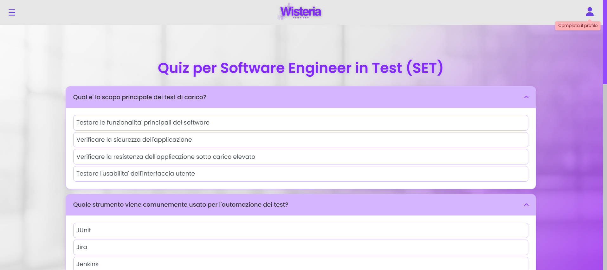

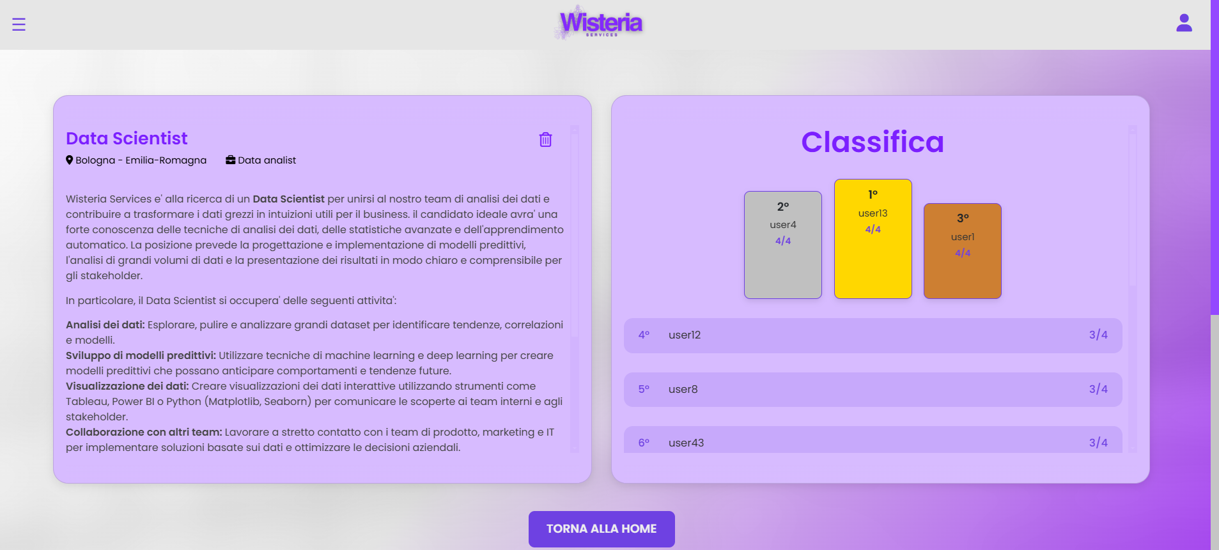


CUSTOMIZATION
TAILORED QUIZZES
EASY TO ACCESS RESULTS
Hard Skills
Soft Skills

Slide 8





SECURITY
PASSWORD HASHING WITH BCRYPT
PERMISSIONS
+
=
a b c

Slide 9
THANK YOU

